Slide 1

Department of Computer Science and Engineering MINI - PROJECT Topic : “BUILDING GENERATIVE AI APPLICATION” Name: Rakshita M USN: 3PD21CS071 Name: Syeda Sidra Quadri USN: 3PD21CS119 Under the guidance : Dr.Pooja A

Slide 2
ABSTRACT
This project aims to develop a generative AI application that can generate new data, manipulate existing data, and provide insights for various industries.
The system will utilize advanced machine learning algorithms and natural language processing techniques to create a robust and scalable solution.
Keywords: Generative AI, Data Generation, Data Manipulation, Machine Learning, Natural Language Processing

Slide 3
CONTENTS
Introduction
Literature review
Problem definition
Objective
Proposed methodology
Working principle
Technical specification
Results & Discussions
Conclusion

Slide 4
INTRODUCTION
Generative AI refers to the use of machine learning algorithms to generate new data or manipulate existing data. Applications include text generation, image generation, and music generation.
Generative AI has the potential to revolutionize industries such as entertainment, healthcare, and finance.
Current systems are limited in their ability to generate diverse and realistic data. Many applications require large amounts of high-quality training data.
Our system aims to address these limitations by developing a robust and scalable generative AI application.

Slide 5
LITERATURE REVIEW
Introduction
Text summarization condenses information while preserving key content. The development of AI applications has significantly advanced this area, especially with large language models (LLMs).
Summarization Techniques
Extractive Summarization: Selects key sentences from the text (e.g., TextRank, LSA).
Abstractive Summarization: Generates new sentences, utilizing sequence-to-sequence models and attention mechanisms.
This system is widely used in applications like news aggregation, academic research, and document summarization to streamline information consumption.

Slide 6
Image Generation :
Text-to-Image AI generators are powerful tools that can simplify the image creation process and enhance creativity. They offer a fast, easy, and limitless way to produce unique and visually appealing visuals for various purposes.
Diffusion models generate high-quality images by iteratively refining noisy data into detailed images.
Diffusion models have demonstrated strong performance in creating realistic and contextually accurate images from text prompts.
Innovations in training techniques and computational efficiency have improved their ability to generate high-quality images while reducing resource demands.

Slide 7
PROBLEM DEFINITION
Generate concise and coherent summaries from lengthy paragraphs.
Create visually accurate and contextually relevant images based on textual descriptions.
The challenge is to design a system that seamlessly combines these functionalities, ensuring that each component performs effectively while maintaining a cohesive user experience. The application should be capable of understanding complex inputs, generating high-quality summaries and images, and providing accurate, context-aware responses to user queries.

Slide 8
OBJECTIVE
Main goal: Develop an application for image generation and text summarization.
Specific objectives:
Provide accurate attribute extraction from images.
Enable concise topic summarization of visual content.
Ensure user-friendly interface for non-experts.
Expected outcomes: Improved understanding and engagement with visual media.
Long-term vision: Establish the application as a go-to tool for image analysis.

Slide 9
PROPOSED METHODOLOGY
This application uses the Hugging Face BERT-base-uncased model to generate summaries of input paragraphs. The model was fine-tuned on a custom dataset of texts to improve its performance on our specific task."
It also utilizes the Stable Diffusion model, a generative adversarial network (GAN) based on diffusion processes. The model was trained on a large dataset of images and text pairs, with a custom loss function that balanced text and image reconstruction.
Future work includes exploring more advanced computer vision techniques, such as Generative Adversarial Networks (GANs) or Variational Autoencoders (VAEs), to improve image quality and diversity.

Slide 10
Working principle
User Input
Preprocessing (Tokenization, Normalization , etc.)
Text Summarization (Hugging Face Transformers)
or
Text -to-Image Generation (Stable Diffusion, GAN, etc.)
Post- processing (Image Enhancement , Filtering , etc.)
Output (Summarized Text, Generated Image)

Slide 11
TECHNICAL SPECIFICATIONS
Software Requirements:
Hugging Face Hub -- it is a cloud storage space where all the transformers free models are stored.(Gpt2,llama3, Bert , etc)
Transformers library -- we use this library to download the models from hugging face hub
Pipeline -- it is a function use to download a model for a particular task.
Task – summarize the given paragraph and image generation.
Gradio -- its a front end design library use to make Graphical user interface for transformers model very easily
Stable Diffusion -- is a deep learning model that generates high-quality images from textual descriptions by iteratively refining noisy data into detailed visuals.
Hardware Requirements:
Minimum and recommended specifications (CPU, RAM).
Necessary server infrastructure for processing.

Slide 12
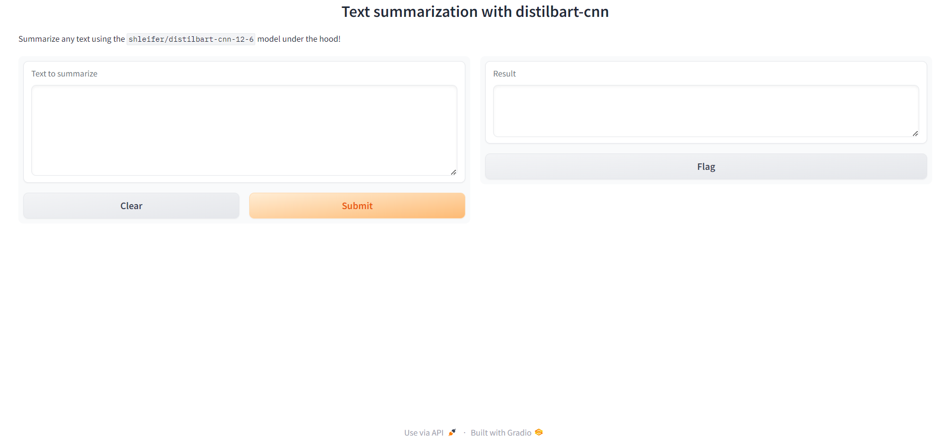
RESULTS & DISCUSSIONS
Text summarization

Slide 13
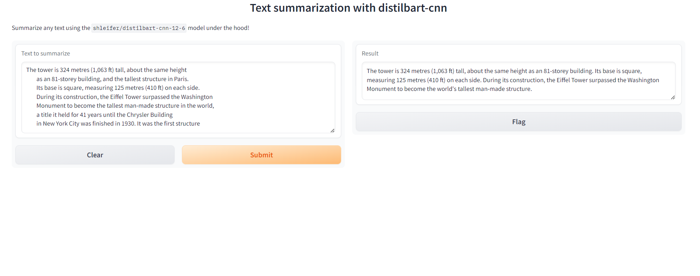
Result

Slide 14
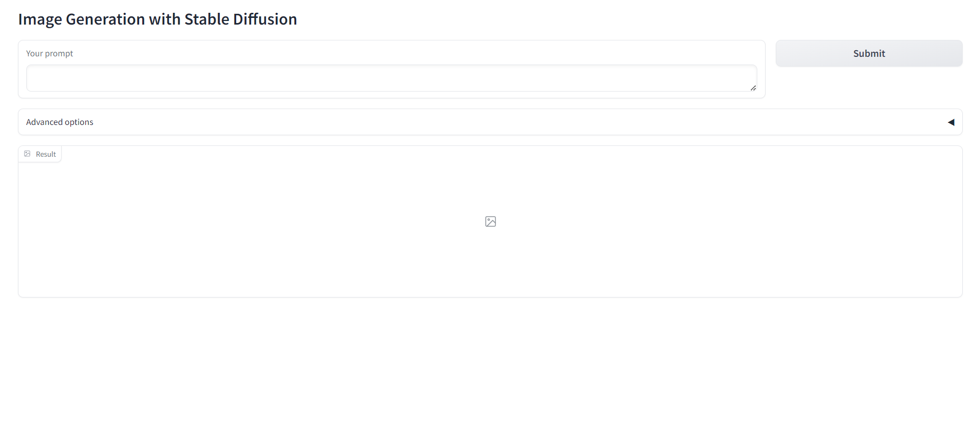
Image generation

Slide 15
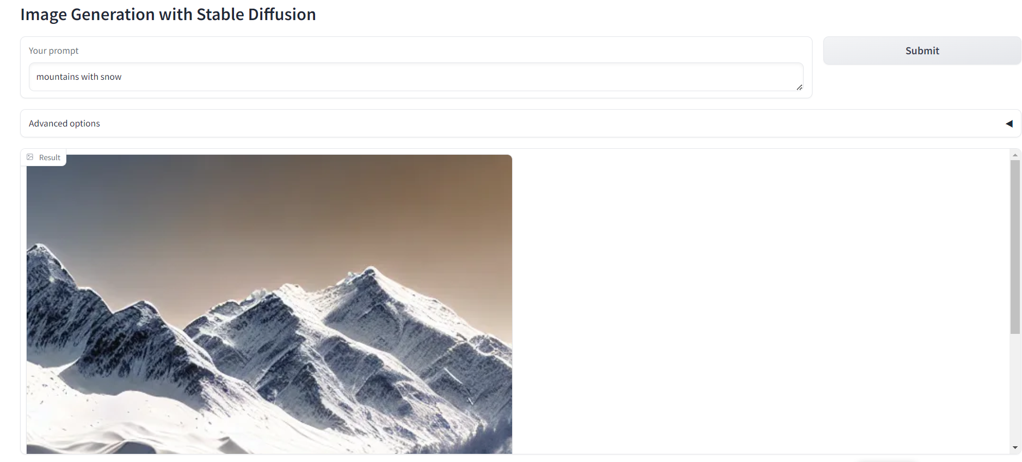
Result

Slide 16
CONCLUSION
Implications for different applications in AI
Recommendations for further development and user training.
Acknowledgment of limitations encountered.
Generative AI refers to the use of machine learning algorithms to generate new data or manipulate existing data. Applications include text generation, image generation, and music generation. Generative AI has the potential to revolutionize industries such as entertainment, healthcare, and finance.

Slide 17
THANK YOU

